Slide 1
Crime Prediction Using Classification Approaches Student: Mariela Marmanillo Mendoza ID Number: 501188993 April 4, 2024

Slide 2
Overview
Toronto, most populous and multicultural city in Canada.
Perception of increasing crime incidents leading to a feeling of insecurity.
Can machine learning correctly classify future crimes in Toronto based on a 10-year of historical crime occurrence?
Motivation
Aid decision-makers in developing a plan with better-targeted interventions to improve community safety.

Slide 3
Research Questions:
How do the accuracy levels of machine learning classification algorithms—such as Decision Tree, K-Nearest Neighbors, and Naïve Bayes—compare in analyzing crime incidents in Toronto?
Which factors—temporal patterns (time of day, day of the week, month) or spatial patterns (location, premises, neighborhood)—provide more accurate predictions of crime occurrences?
How do the results from this research contribute to understanding historical crime patterns and developing targeted interventions to improve community safety?

Slide 4
The Dataset
Source: Toronto Police Service public safety Data portal.
Privacy: Compliant with the Municipal Freedom of Information and Protection of Privacy Act.
Data Integrity: Collected data verified through police investigation.
Size: 372,899 observations x 31 features.
Key Attributes:
Dates and times of crime reporting and occurrence.
Police division, location type, premises type.
UCR code and extension, offence, MCI category.
Neighborhood identifiers.
Latitude and longitude coordinates.
5-Class Target Variable:
Major Crime Indicators (MCI)
Assault
Auto Theft
Break and Enter
Robbery
Theft Over

Slide 5
Supervised Machine Learning Algorithms
Decision Tree
K-Nearest Neighbors
Naïve Bayes

Slide 6
Project Approach
Literature Review & Data Description
Existing Literature Studied
Raw Data Description / EDA
Abstract
Project Description/Open Dataset
Research Questions / ML Tools
Feature Selection
Data Cleaning & Pre-Processing
Model Development
Model designed for each algorithm
Training on train data set
Model Implementation
Classification Algorithms Training
Model Evaluation
Performance on classification models
Results and conclusions

Slide 7
Cleaning Dataset
Removing duplicate rows (47,920).
Omitting missing values (88).
Dropping rows with data to years other than period 2014-2023 (1,171).
Dropping rows that contains NSA in variables related to neighborhood structure (5,066).
From 372,899 to 318,654 observations
after data cleaning.

Slide 8
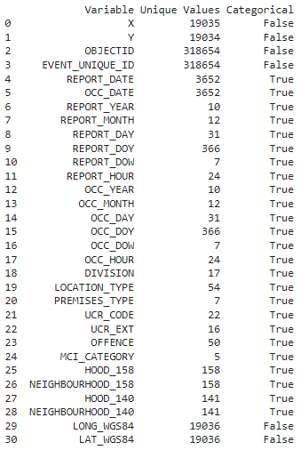
Categorical Variable Identification

Slide 9
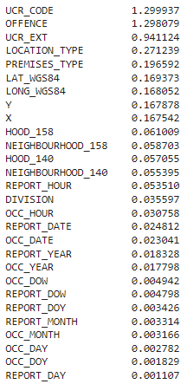
Feature Selection
Scores
Filter-based Technique:
Information Gain
Considerations:
Applied in the training set
Not considered ID-related variables
Dataset size after feature selection: 318,654 rows × 9 columns

Slide 10
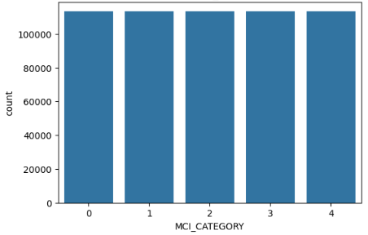
Class Imbalance - SMOTE
 | Assault | Auto Theft | B&E | Robbery | Theft Over
# of Counts | 113,759 | 46,842 | 35,689 | 17,845 | 8,922
% of Counts | 51% | 21% | 16% | 8% | 4%

Slide 11
Model Implementation – 1st Attempt
Feature Selection Technique: Information Gain
Accuracy Results
Classifier | Method
 | Train Test Split |  | 10-fold Cross Validation
 | Training Set | Test Set | Training Set | Test Set
Decision Tree | 100.0% | 100.0% | 100.0% | 100.0%
KNN | 89.1% | 73.5% | 81.8% | 73.5%
Naïve Bayes | 99.5% | 99.1% | 99.4% | 99.1%
Model Implementation time: DT = 13s / KNN = 43m 22s / NB = 1m 56s

Slide 12
Model Implementation – 1st Attempt
Precision and Recall Metrics by Class
Decision Tree | Assault | Auto Theft | B & E | Robbery | Theft Over
Precision | 1.00 | 1.00 | 1.00 | 1.00 | 1.00
Recall | 1.00 | 1.00 | 1.00 | 1.00 | 1.00
KNN | Assault | Auto Theft | B & E | Robbery | Theft Over
Precision | 0.93 | 0.63 | 0.59 | 0.46 | 0.25
Recall | 0.87 | 0.63 | 0.63 | 0.54 | 0.30
Naïve Bayes | Assault | Auto Theft | B & E | Robbery | Theft Over
Precision | 1.00 | 0.99 | 1.00 | 0.90 | 1.00
Recall | 0.98 | 1.00 | 1.00 | 1.00 | 0.97

Slide 13
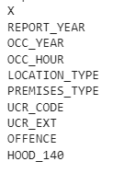
Model Implementation – 2st Attempt
Revisiting Feature Selection: Select K Best Technique
Accuracy Results
10 Best Features
Classifier | 10-fold Cross Validation
 | Training Set | Test Set
Decision Tree | 100.0% | 100.0%
KNN | 97.9% | 93.6%
Naïve Bayes | 100.0% | 100.0%

Slide 14
Conclusions
Concerns arise regarding accuracy scores for selected ML algorithms, highlighting potential issues like overfitting.
Decision Tree and Naïve Bayes show potential issues, while KNN emerges as the most reliable model for crime prediction in Toronto.
Location-related variables are identified as most influential for classification models after two feature selection techniques.
KNN method demonstrates potential for forecasting crime in all major crime indicators categories, except for "Theft Over".
The results help with public awareness of high-risk areas, aiding Toronto Police Service in crime prevention efforts.

Slide 15
Limitations of the Project
Feature selection methods were restricted to information gain and SelectKBest, excluding exploration of other techniques.
Class imbalance was addressed solely through SMOTE; alternative sampling methods were not investigated.
Categorical variables were encoded using label encoder due to technical constraints, limiting exploration of alternative methods.
Data scaling was not implemented, potentially impacting model performance; alternative transformation methods were not explored.
Performance metrics of 100% were obtained, but their underlying reasons remain unclear despite various attempted solutions.

Slide 16
Thank you.

